Slide 1


PRESENTATION
BITCOIN PRICE PREDICTION

Slide 2
TEAM
Faith Nanzala
Sammy Murimi
Felista Mueni
Joseph Leshakwet
June Njuraita
Sylvia Nganga

Slide 3

TABLE OF CONTENTS
Overview
Problem Statement
Objectives
Findings
Conclusion
Recommendations

Slide 4
OVERVIEW
Cryptocurrency, a form of digital currency that operates independently of a central authority and uses encryption techniques to secure transactions, has become increasingly popular over the years. Some of the most commonly known cryptocurrencies include Bitcoin, Ethereum, Litecoin, and Ripple. Bitcoin, in particular, has gained popularity as a medium of exchange and has been adopted as legal tender by some countries, including Ecuador and the Central African Republic. Cryptocurrencies have also become an investment option for many, with the forex market listing Bitcoin as a currency for making profits. To monitor cryptocurrency prices and market trends, investors often rely on platforms like CoinMarketCap, which provides unbiased, high-quality, and accurate information.

Slide 5
PROBLEM STATEMENT
Despite its popularity, the Bitcoin market is relatively new and has been subject to high volatility. There is a need to understand the factors that drive the price of Bitcoin, and to make predictions about future price movements. The information from our analysis will help potential investors to make sound decisions in regards to buying and selling of bitcoin.

Slide 6

OBJECTIVE
Our main objective is to predict the price of bitcoin.
Specific Objectives
Identify the trends of bitcoin.
Identify the features that have an impact on bitcoin.
Identify the highest volume recorded by Bitcoin (USD).
Identify the lowest volume recorded by Bitcoin (USD).

Slide 7


FINDINGS

Slide 8
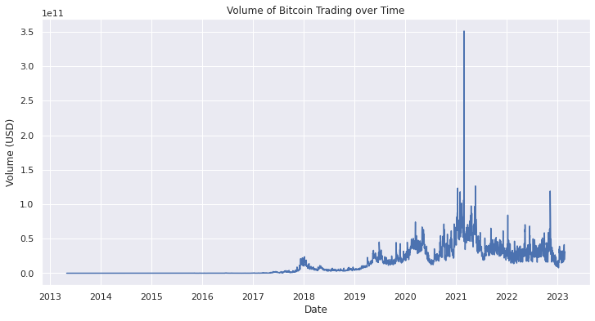
PLOT SHOWING THE VOLUME OF BITCOIN OVER THE YEARS

Slide 9
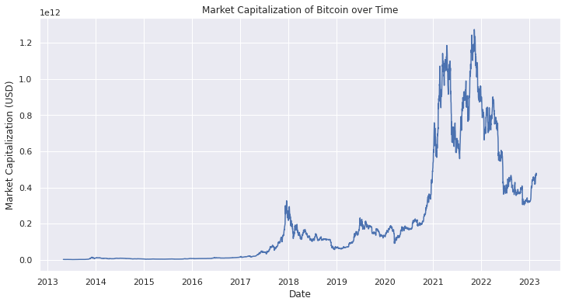
PLOT SHOWING THE MARKET CAPITALIZATION OF BITCOIN OVER THE YEARS

Slide 10
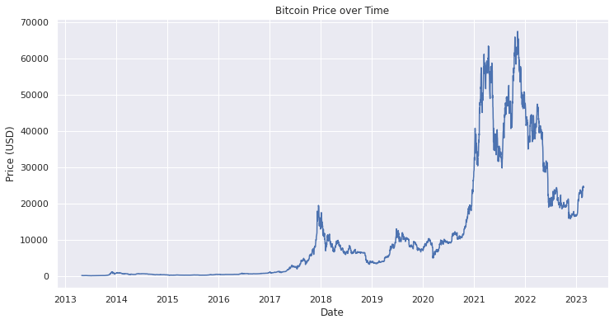
BITCOIN PRICE OVER THE YEARS

Slide 11
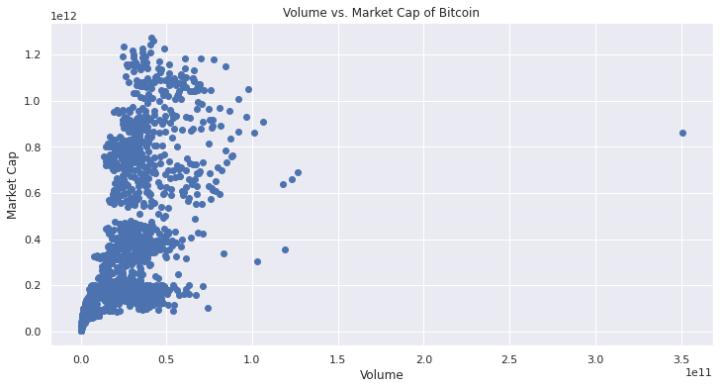
VOLUME vs MARKET CAPITALIZATION OF BITCOIN

Slide 12
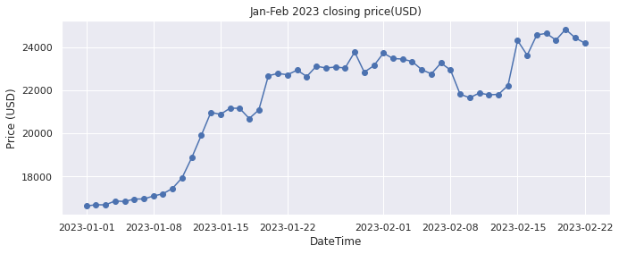
PLOT SHOWING DAILY PRICES OF BITCOIN FROM JANUARY TO FEBRUARY, 2023

Slide 13
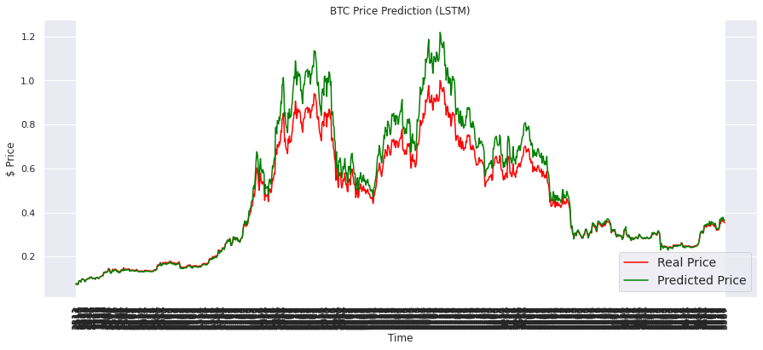
REAL PRICE vs PREDICTED PRICE OF BITCOIN

Slide 14
CONCLUSIONS
Bitcoin has generally been increasing in price, it sometimes falls but it then recovers and continues rising
The opening price the high price and the volume together with market capitalization affects the price of bitcoin
Bitcoin has recorded a volume of zero and has gone to as high as 35,000,000,000

Slide 15
RECOMMENDATIONS
For the investors who want to invest in bitcoin, they can invest as the price will rise in the long term.
Bitcoin is a good cryptocurrency to invest in as the volume traded and the market capitalization have risen very much making it good to invest in.

Slide 16

THANK YOU

